Slide 1
Ares
Ádám Blázsek, Ralfs Zangis, Andrei Eugen Birta
Notes:
Fix pictures

Slide 2
Agenda
Intro
Problem statement
Proposed solution
System development
System architecture
Tests
Risk analysis + test coverage
Resources
Test strategy
Test approach
Static
Dynamic
Database
EER
Db Diagram
Business logic
Test methodology
Views
Stored procedures
Triggers
Script optimization
Security

Slide 3
Problem statement
•GTL – a library which has no current software implementation of anykind
•Requires statistical information from its users
•Requires communication with other libraries

Slide 4
Our solution
•A distributed WCF application with the following features:
•User authentication
• Loaning and returning materials
• Ability to gain meaningful insights into user’s reading behavior, through the use of statistical tools
• Automated notifications for lent books outside the grace period
• Duplicate business logic in both the database and c#

Slide 5
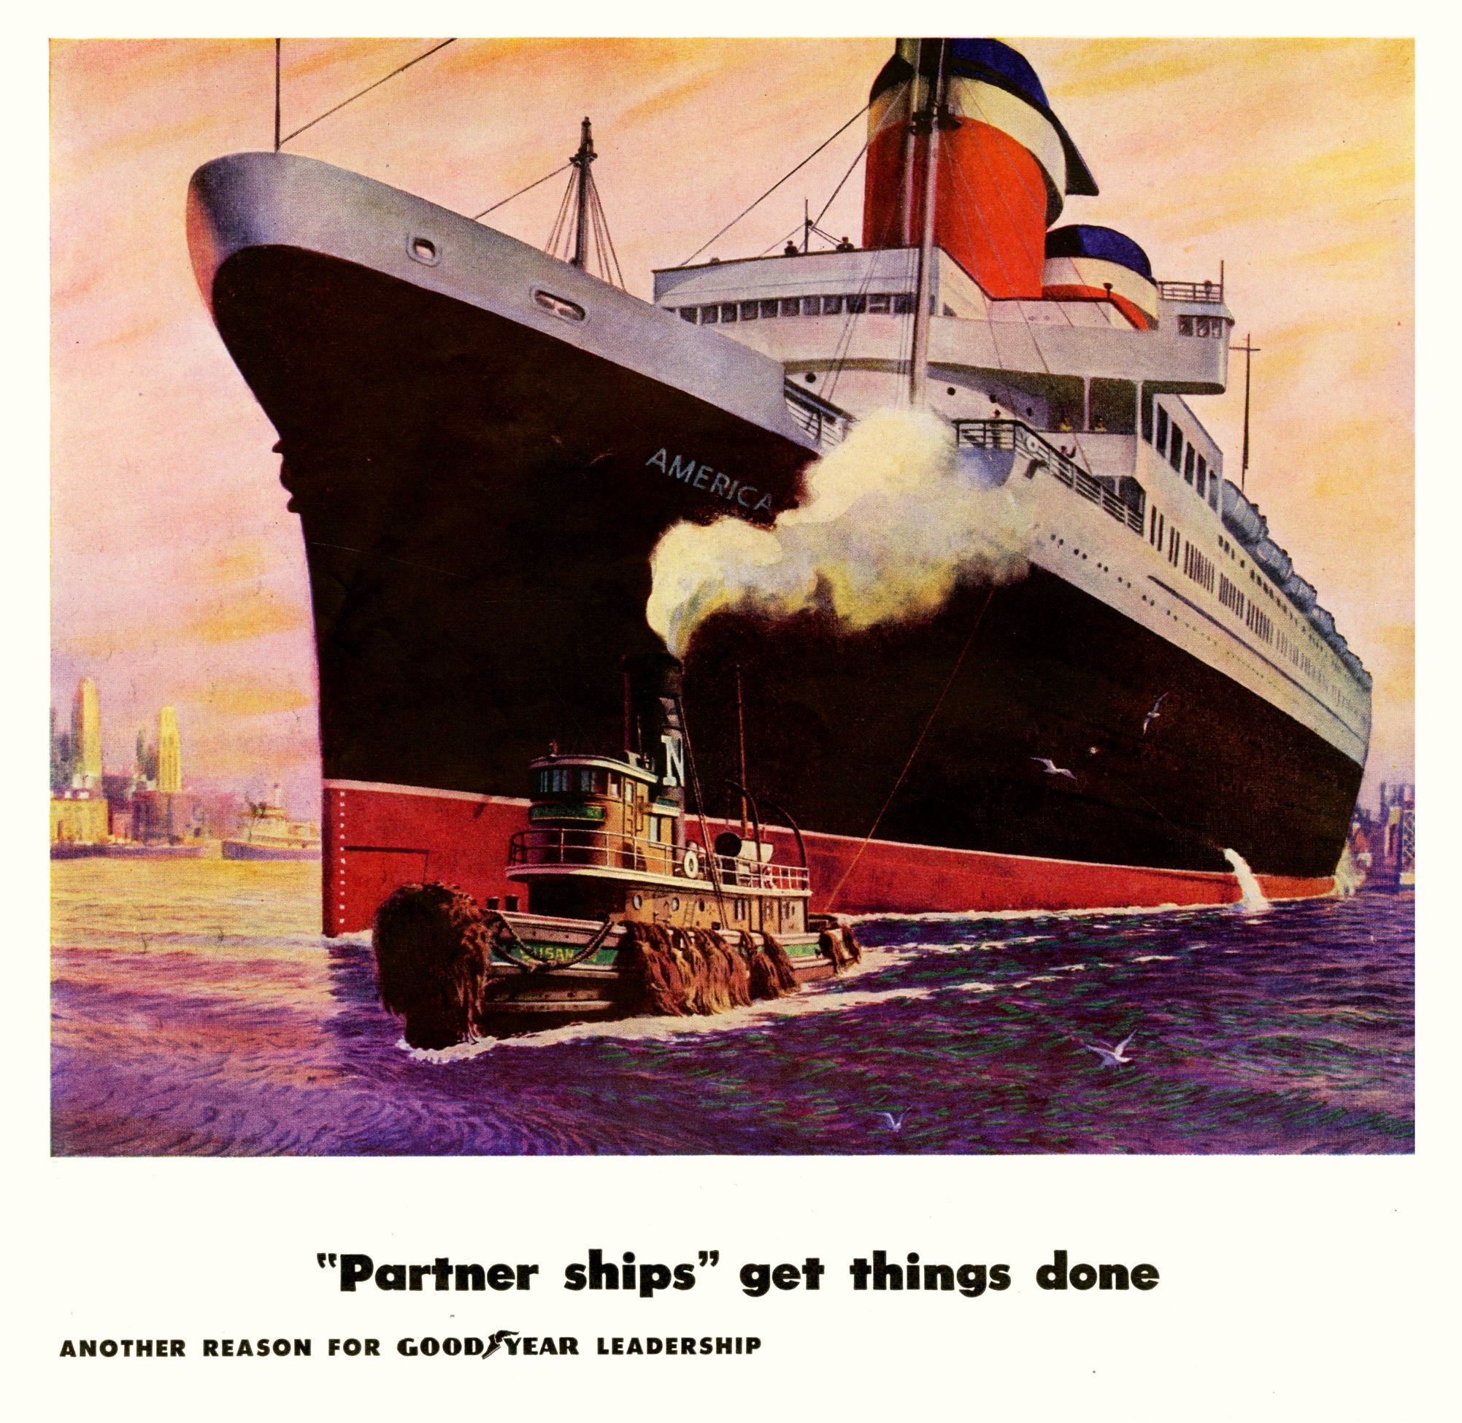
The most important part

Slide 6
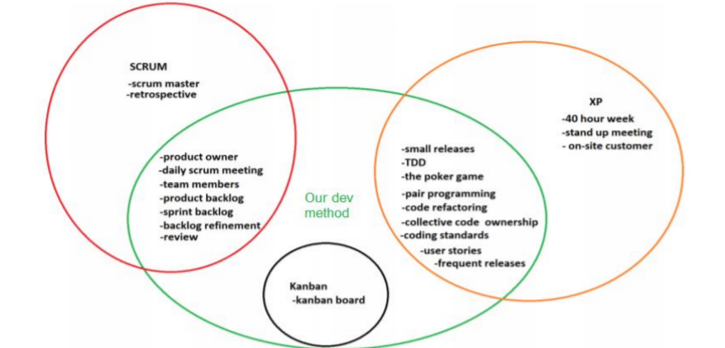
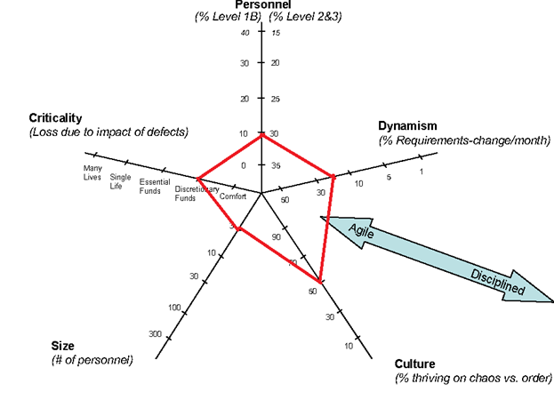
System development
Why its important:
- improves product and work quality
- improves productivity
- helps with workflow
- defines roles and rules
Notes:
when making the architecture for the task at hand, it was decided to follow trends established
in the previous projects. With architecture being further modified, based on the previous experience, by making it easier to work with, while also accomodating the new requerements of this solution, such as improving testability and allowing switching between different approaches of dealing with data.
*Show and explain diagram*
In the image we can see how each project communicates and interacts with each other, allowing us to better understand
how it works. Different projects are meant for doing a specific tasks, GtlWebsite is for holding user interface,
GtlService performs the business requirements, Core is providing models used through out the product
and tests ensures the final product's quality, by verifying previously mentioned project outcomes.
1:40

Slide 7
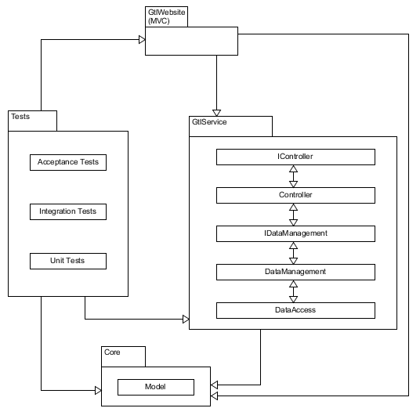
System architecture
Easy to work with
Testable
Ability to use different aproaches
Notes:
when making the architecture for the task at hand, it was decided to follow trends established
in the previous projects. With architecture being further modified, based on the previous experience, by making it easier to work with, while also accomodating the new requerements of this solution, such as improving testability and allowing switching between different approaches of dealing with data.
*Show and explain diagram*
In the image we can see how each project communicates and interacts with each other, allowing us to better understand
how it works. Different projects are meant for doing a specific tasks, GtlWebsite is for holding user interface,
GtlService performs the business requirements, Core is providing models used through out the product
and tests ensures the final product's quality, by verifying previously mentioned project outcomes.
1:40

Slide 8

Testing

Slide 9
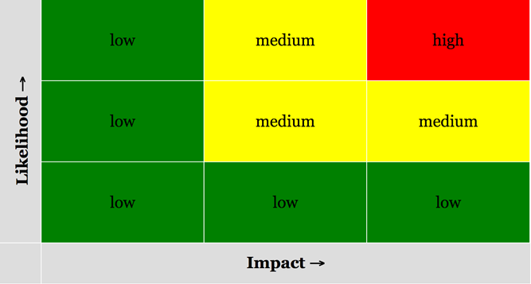
Risk analysis
•Conducted via estimates and peer reviews with the help of a risk matrix
•Each risk level is color coded for transparency
Notes:
We took a risk based approach
Likelyhood and the impact of a scenario gives it its rating
The analysis is Conducted via guesstimates Color coding

Slide 10
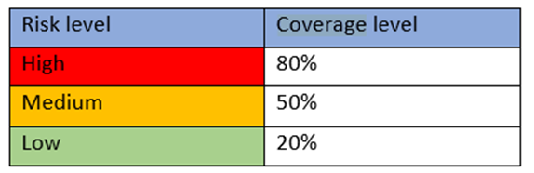
Test coverage
•Directly correlated to risk analysis
•Great for defect prevention early on in the project lifecycle
•Helps with maintaining a high quality software
Notes:
NOT all possible combinations of data values or paths can be tested
Coverage is a way of defining how much of the code that are actually exercised by the tests
50% and 20% coverage level means it is prone to defects if the user deviates from the expected path

Slide 11
Our resources
• Three students with a budget of 0 dkk
• We mainly relied on free to use software and hardware we already had
• We had no focus groups to validate our solution
• To expand our intellectual resource we contacted the real Georgia Tech University Library

Slide 12
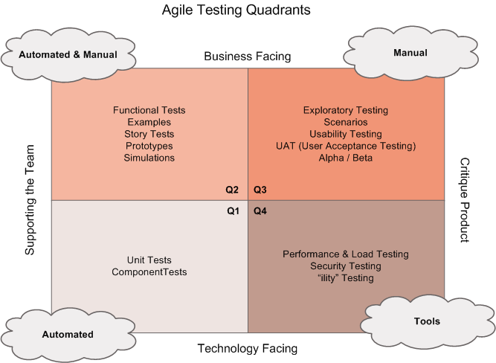
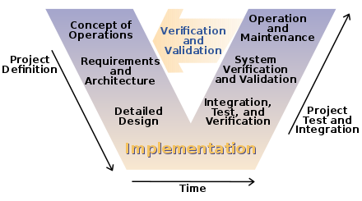
Test methodology
Notes:
For our solution we considered two different testing methodologies, those being: V-Model and 4 quadrants.
___ V-Model is a diagram representing the software development life cycle, which summarizes the main
verification and validation preparation steps to be taken in conjunction with the implementation of the system,resulting in the iconic V-shape.
___ The quadrants are a map helping teams plan their testing and making sure they have all the resources they need
to accomplish it. There are no preset rules where each test goes, thus it is left to team to decide, however there
are some guidelines, deviding tests into business and technology facing, as well as ones criticizing the product or
supporting the team.
After reviewing the benefits of them, we opted to use V-model approach, as it was stricter framework for
developing high value applications and we believed it would better fit the requirements of the solution in need.
1:40

Slide 13
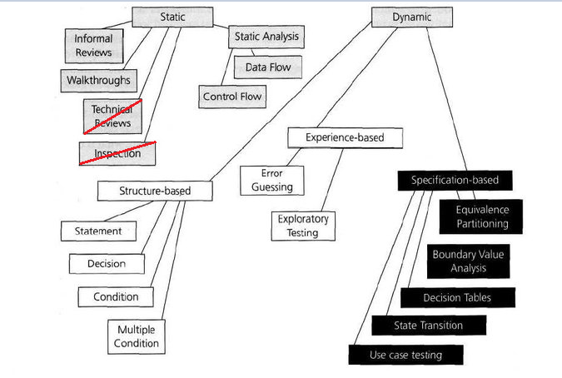
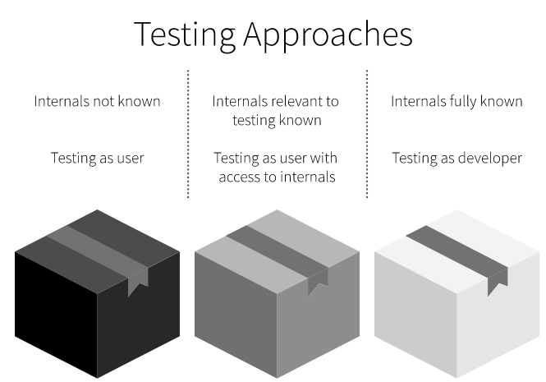
Test approach
Notes:
Testing approach refers to the exact "implementation", so to say, of the way we tested our project. And given the risks that Adam talked about, we decided to go with a proactive approach, in the sense that we started testing even before the build was created.
And we can categorize our testing in 3 different ways: black, gray and white box testing. Now the difference between them is the way we treat the product when testing, in the sense of: how much of the actual implementation do we consider when creating tests.
Going a bit deeper into this: in this image we can see the actual techniques that we used, categorized on whether they are preventive or curative. While the colors represent the boxes they would belong into. And we can see we have used quite a few techniques. Although both static and dynamic were used everywhere in the project, they are also somewhat specialized. For example: in this project, static testing is prevalent in places where documentation is at play, so report, diagrams, planing, or tougher bits of code like the java scripts...
Where dynamic is prevalent in places where code is at play.
(2:30-2:50min)

Slide 14

Database

Slide 15
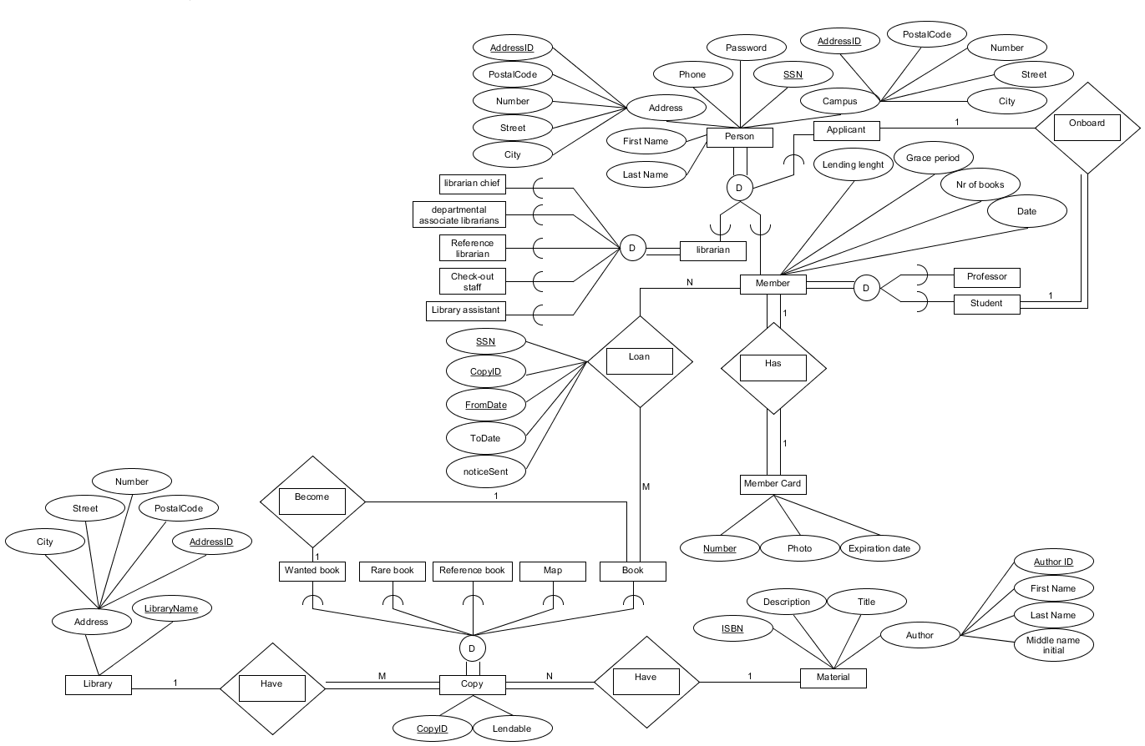
Enhanced Entity Relationship diagram
Notes:
An Entity Relationship diagram is a type of flowchart that illustrates how “entities” such as people, objects or concepts relate to each other within a system. Now since we worked in agile, this represents only the final version of it. Looking at the diagram, you can see that we mapped pretty much all of the entities we managed to identify, that GTL would have to deal with. Now, there are some entities, that don't have relationships, such as: all of the different librarians, or the different types of materials, but they do have a different type of interaction. For example: only books can be lent out to members, and only wanted books can be acquired by the librarians later on transforming into books.
Using this diagram, we created our database diagram.

Slide 16
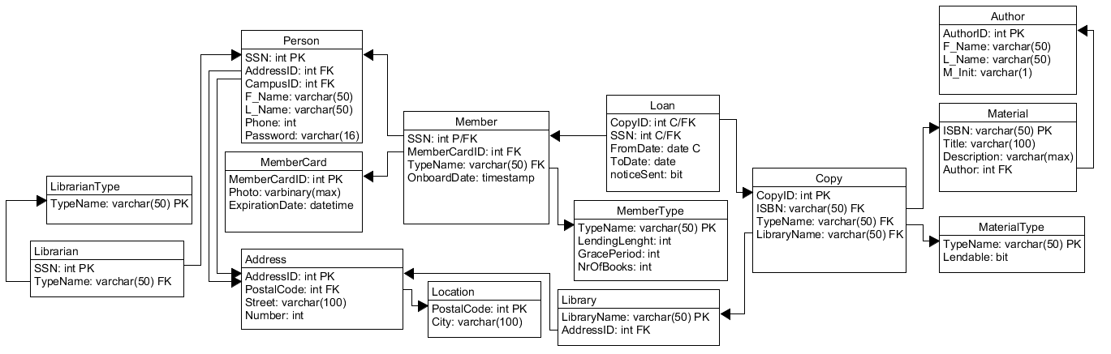
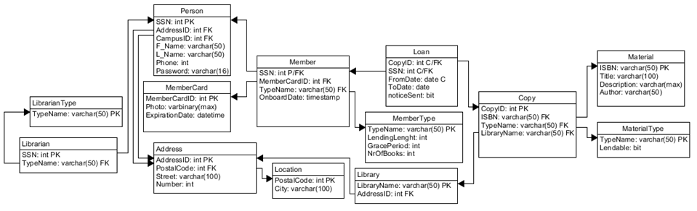
Database diagram
Notes:
Speaking of: This picture depicts how our database looks like. Although this isnt a typical db diagram, we decided to go with this to save up space, after all there's only that much screen estate. And this was created using the 9 mapping steps from EER to db diagram. We also tried respecting the Normalization forms as much as possible and following a few meetings with Jakob, we reached the conclusion that it holds up to the Boyce Codd normalization form. But why is it important to respect the normalization forms? Because they ensure that a relational database is useable, stable and as efficient as possible. Some of, rather "odd", things we had to do to achieve that was, for example: here at address and location, where we had to put city and postal code in a separate table, since a cities and postal codes tend to related to one another, making a non-key attribute depend on another non-key attribute, which violates the 3NF
(2:40-2:55 min)

Slide 17
Business logic
Views
Triggers
Stored procedures
Notes:
As we decided to implement the business logic twice, once to demonstrate database capabilities and once for testing purposes, the following part will showcase some of the database implementations of it.

Slide 18
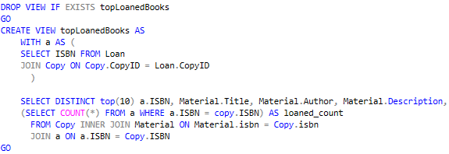
Views
Notes:
Database views are searchable virtual objects used in relational databases. Unlike ordinary base tables a view is not
a part of a physical schema instead being defined by stored SQL queries. Views can consist of two or more combined tables, if data
is changed in one of the tables used to create the view, the view will automatically hold the newest information once it is called again.
As can be seen in the image, this view is used for getting the top 10 most loaned books.
1:00

Slide 19
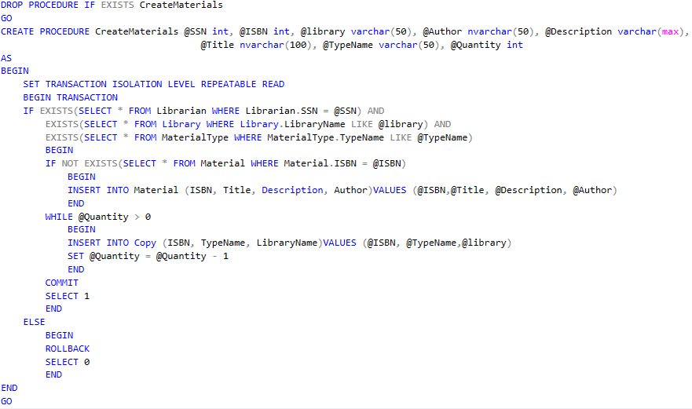
Stored procedures
Notes:
A stored procedure is a prepared SQL query that can be saved and later called to execute certain pre planned changes.
It can be reused multiple times and works simalary as methods in other programming languages, by allowing input parameters and return values.
The use of stored procedures were usefull to reduced the duplication of the code, which means, that solution not only was
much easier to maintain, but also to expand.
The example shows procedure, where creation of materials and copys can be atcheived by providing the requered paramaters,
with results differeng based on the input.
0:50

Slide 20
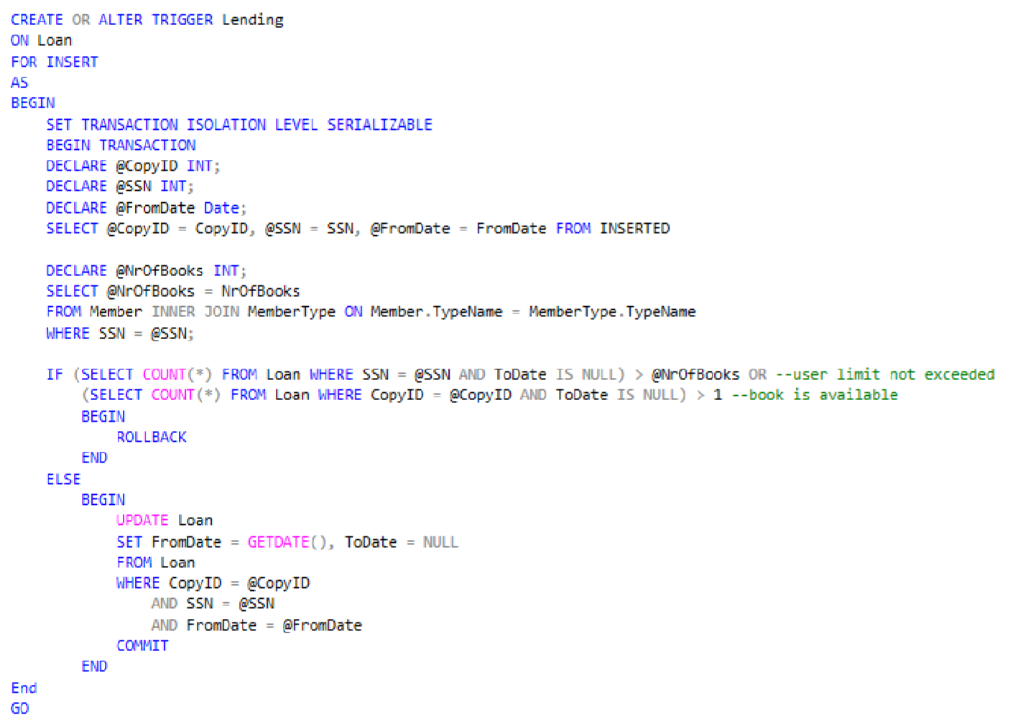
Triggers
•What are triggers ?
•How a trigger was chosen ?
•What is it used for ?

Slide 21
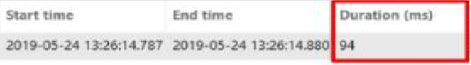
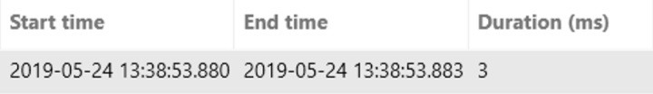
Script optimization
•We mainly focused on one area
•How we did it
•What the improvements were

Slide 22
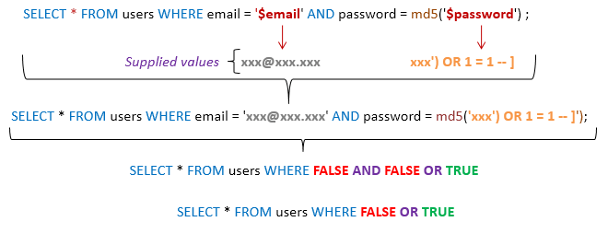
Security
Notes:
Security is a big subject, but due to the fact that we had limited time to work on it, we decided to not focus on
it, instead accomplishing only the basic requeriments of a potentianaly usable solution. In the end implementing only
simple authentification solution with basic protection against some of the most common attacks like sql injection (img), while planing on
introducing authorezation in later stages of the developmant.
0:40

